Slide 1
A comparative study on decentralized storage platforms
Yoon-Jin Han, Geun-Hyung Kim

Slide 2
Introduction
Decentralized Storage Platform
- IPFS
- Filecoin
- Sia coin
- Storj
- NeoFS
- SAFE network
Conclusion

Slide 3




Centralized Storage
File

Slide 4




Disadvantages of Centralized Storage
1
If a server fails, it can be temporarily paralyzed,
or it mat lose data
2
Centralized Server can also provide data to third parties
without the permission of the data owner
3
Users who are far away from the server’s location
may experience slower data transfer speeds
4
The amount of storage in Centralized Storage is
limited causes cost is increasing
Far

Slide 5

Decentralized Storage
File

Slide 6










Decentralized Storage Requirement Specification
Data must be distributed and stored across multiple nodes that participate in the network
make sure that the Centralized Server does not manage the data
Users should always have access to their data
It has to be cheaper than centralized storage

Slide 7




Malicious virus data?
Due to the characteristic of Decentralized Storage, which stores and distributes data, malicious users can suffer damage from storing malicious virus data.
For this reason, I researched the types of Decentrated storage platforms this time.

Slide 8
InterPlanetary File System
IPFS
Notes:
IPFS(InterPlanetary File System)는 중앙집중형 서버 없이 개개인이 네트워크로 연결되어 생성하는 분산웹을 위해 Protocol Labs에서 개발한 프로토콜이다.

Slide 9
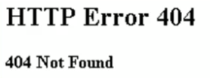
Content-based addressing
File
① File Upload
IPFS Network
② File Hash Value
Qmrjsk3ekrj35fj4k
Location-based Address
Content-based Address
http://example.com/test.txt
Ipfs.io/Ipfs/Qmrjsk3ekrj35fj4k
Qmrjsk3ekrj35fj4k | Node 1
 | Node 4
 | Node 7
Distributed Hash Table
Notes:
Use Content Identifiers to Address Files

Slide 10
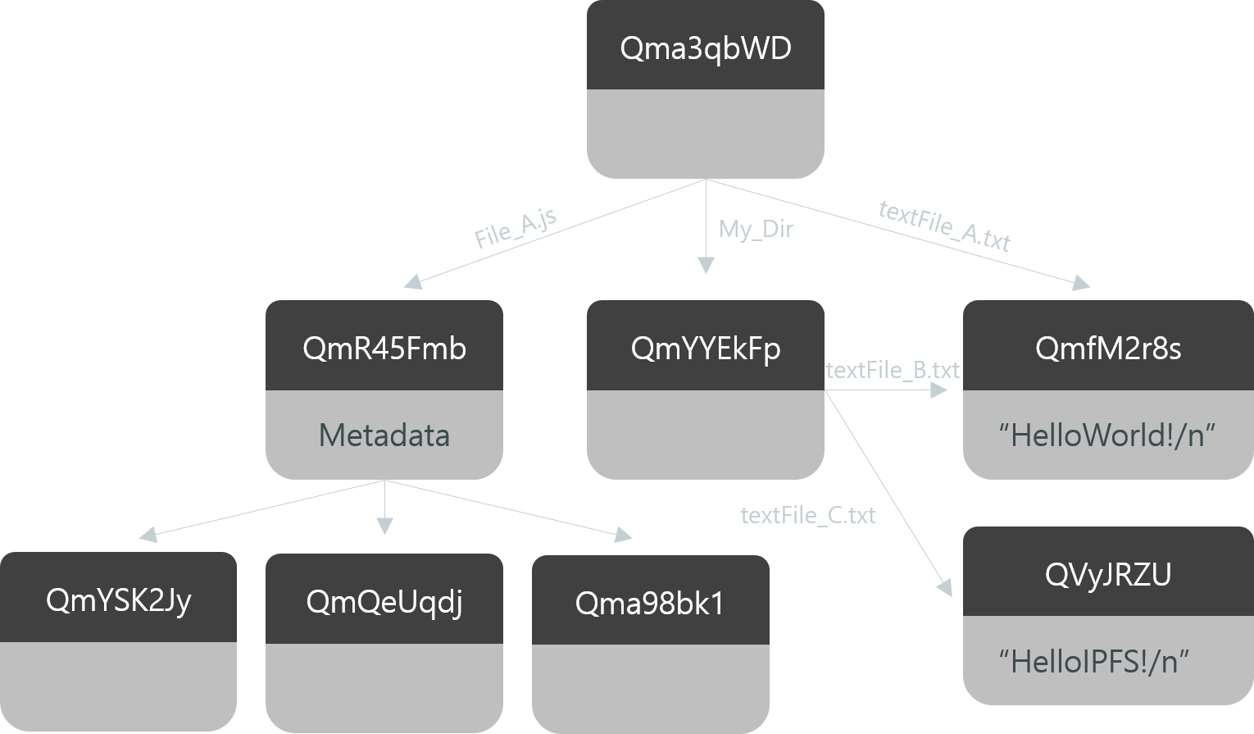
Merkle DAG(Directed Acyclic Graph)
Dir
└ File_A.js
└ textFile_A.txt
└ My_Dir
└ textFile_B.txt
└ textFile_C.txt
Qma3qbWD
File_A.js
My_Dir
textFile_A.txt
QmR45Fmb
QmYYEkFp
QmfM2r8s
textFile_B.txt
Metadata
“HelloWorld!/n”
textFile_C.txt
QVyJRZU
QmYSK2Jy
QmQeUqdj
Qma98bk1
“HelloIPFS!/n”
Notes:
Use Content Identifiers to Address Files

Slide 11
p1
Merkle DAG(Directed Acyclic Graph)
Qma3qbWD
Dir
└ File_A.js
└ textFile_A.txt
└ My_Dir
└ textFile_B.txt
└ textFile_C.txt
File_A.js
My_Dir
textFile_A.txt
QmR45Fmb
QmYYEkFp
QmfM2r8s
textFile_B.txt
Metadata
“HelloWorld!/n”
textFile_C.txt
QVyJRZU
QmYSK2Jy
QmQeUqdj
Qma98bk1
“HelloIPFS!/n”
Notes:
Use Content Identifiers to Address Files

Slide 12
Filecoin
Notes:
파일 코인은 시스템이자 토큰이다. 1)탈중앙화 방식의 클라우드 스토리지 네트워크이자 2) 해당 블록체인 서비스의 토큰이라고 할 수 있다. 비트코인이 P2P 전자적 캐시 시스템(A Peer-to-Peer Electronic Cash System)이자, 시스템 위에서 발행되는 경제적 인센티브 토큰인 것처럼 말이다.
파일 코인 한 문장으로 요약하자면
"IPFS를 통해 콘텐츠(데이터)를 탈중앙화 시키고 인센티브를 통해 네트워크가 운영되는 클라우드 스토리지 서비스"

Slide 13
What is Filecoin?
Filecoin was developed in Protocol Labs, such as IPFS.
Filecoin used blockchain technology unlike IPFS.
Nodes must provide their own repositories to ensure that the decentralized network operates smoothly.
Provide Filecoin Token as a compensation system to encourage nodes to participate voluntarily.
Notes:
Filecoin은 IPFS와 같이 Protocol Labs에서 개발됨
파일코인은 블록체인 기술을 사용
IPFS가 원활하게 운영되기 위해서는 노드들이 자신의 저장소를 제공하도록 해야함
보상 시스템을 이용하여 파일코인 토큰을 제공해 사람들이 자발적으로 참여하게 함
네트워크에 기여할수록 보상받는 구조

Slide 14


Incentive System
Provides the storage
1
Storage Provider
2
Stores a piece of files
Filecoin
3
Receive as much cost
Notes:
Filecoin is a decentralized storage network that turns cloud storage into an algorithmic market.
Filecoin works as an incentive layer on top of IPFS, which can provide storage infrastructure foe any data.
파일코인은 클라우드 스토리지를 알고리즘 시장으로 바꾸는 분산형 스토리지 네트워크다. 파일코인은 IPFS 위에 있는 인센티브 계층으로 작동하며, 어떤 데이터에도 스토리지 인프라를 제공할 수 있다.

Slide 15
Sia coin

Slide 16


File Contract
1
The File Contract creates contract information,
costs, period of use, and penalties for breach of contract
File Contract
Storage Provider
User/Client
2
File Contracts are stored in the Sia Blockchain
and stored securely
Sia Blockchain

Slide 17
File Upload Sequence
User/Client
Sia Blockchain
Storage Provider
1
Proposition
2
OK + Deposit
3
Storage Choice + Full Payment
4
OK
5
File Transfer

Slide 18
Storage Proof
User/Client
Sia Blockchain
Storage Provider
1
Proof
2
Verification + Payment
3
Proof
4
Verification + Payment

Slide 19
Storj
Notes:
이더리움 기반

Slide 20


Bridge Server
Bridge Server
2
Request
Storage Provider
1
EnCrypt
3
Upload
File
User/Client

Slide 21
Reed-Solomon Erasure codes
Encrypt
Split
Distribute
File
User/Client
Reed-Solomon technology allows you to restore the original file to some pieces

Slide 22
NeoFS

Slide 23
Network Map
Network Map
Container
root
US
EU
Ca
N1
N2
N3
N4
N5
N6
N7
Notes:
Inner Ring nodes monitor the state of NeoFS storage nodes. Using this information, they maintain up-to-date Network Map. It is a multi-dimensional graph where nodes have attributes and are grouped by those attributes and their values. This allows using a special data placement function to find nodes that would store an object when putting or getting it in/from NeoFS network.
내부 링 노드는 NeoFS 스토리지 노드의 상태를 모니터링합니다. 이 정보를 사용하여 최신 네트워크 맵을 유지 관리합니다. 노드에 속성이 있고 해당 속성과 해당 값으로 그룹화 된 다차원 그래프입니다. 이를 통해 특수한 데이터 배치 기능을 사용하여 객체를 NeoFS 네트워크에 넣거나 가져올 때 객체를 저장할 노드를 찾을 수 있습니다.

Slide 24






Homomorphic Cryptography
10
30
20
30

Slide 25
SAFE

Slide 26
Self‑encryption
Hash Value
fdf234h34jr82942j3
File
3jekljr5w349j4i3io23
User/Client
hj4992349u9ia23i4jk

Slide 27
Conclusion

Slide 28
Comparison table of decentralized storage platforms
 | Blockchain | Information on chain | Data Verification | Encryption
IPFS | x | x | Merkle tree | Asymmetric Hashing
Filecoin | Filecoin | Assets, Transaction, Contracts and Proofs | PoSt (Proof-of-Spacetime), PoRep (Proof-of-Replication) | Asymmetric Hashing
Storj | Ethereum | Assets, Transaction | PoS (Proof-of-Storage), Merkle tree | Encryption choices
Sia | Sia | Assets, Transaction, Contracts and Proofs | File Contract (Merkle root hash) | Threefish
NeoFS | Neo | Assets, Transaction, Contracts | Homomorphic Hashing | Homomorphic
SAFE | x | x | Zero Knowledge Proof | Self-encryption

